Slide 1
CS2103 Software Engineering

Slide 2
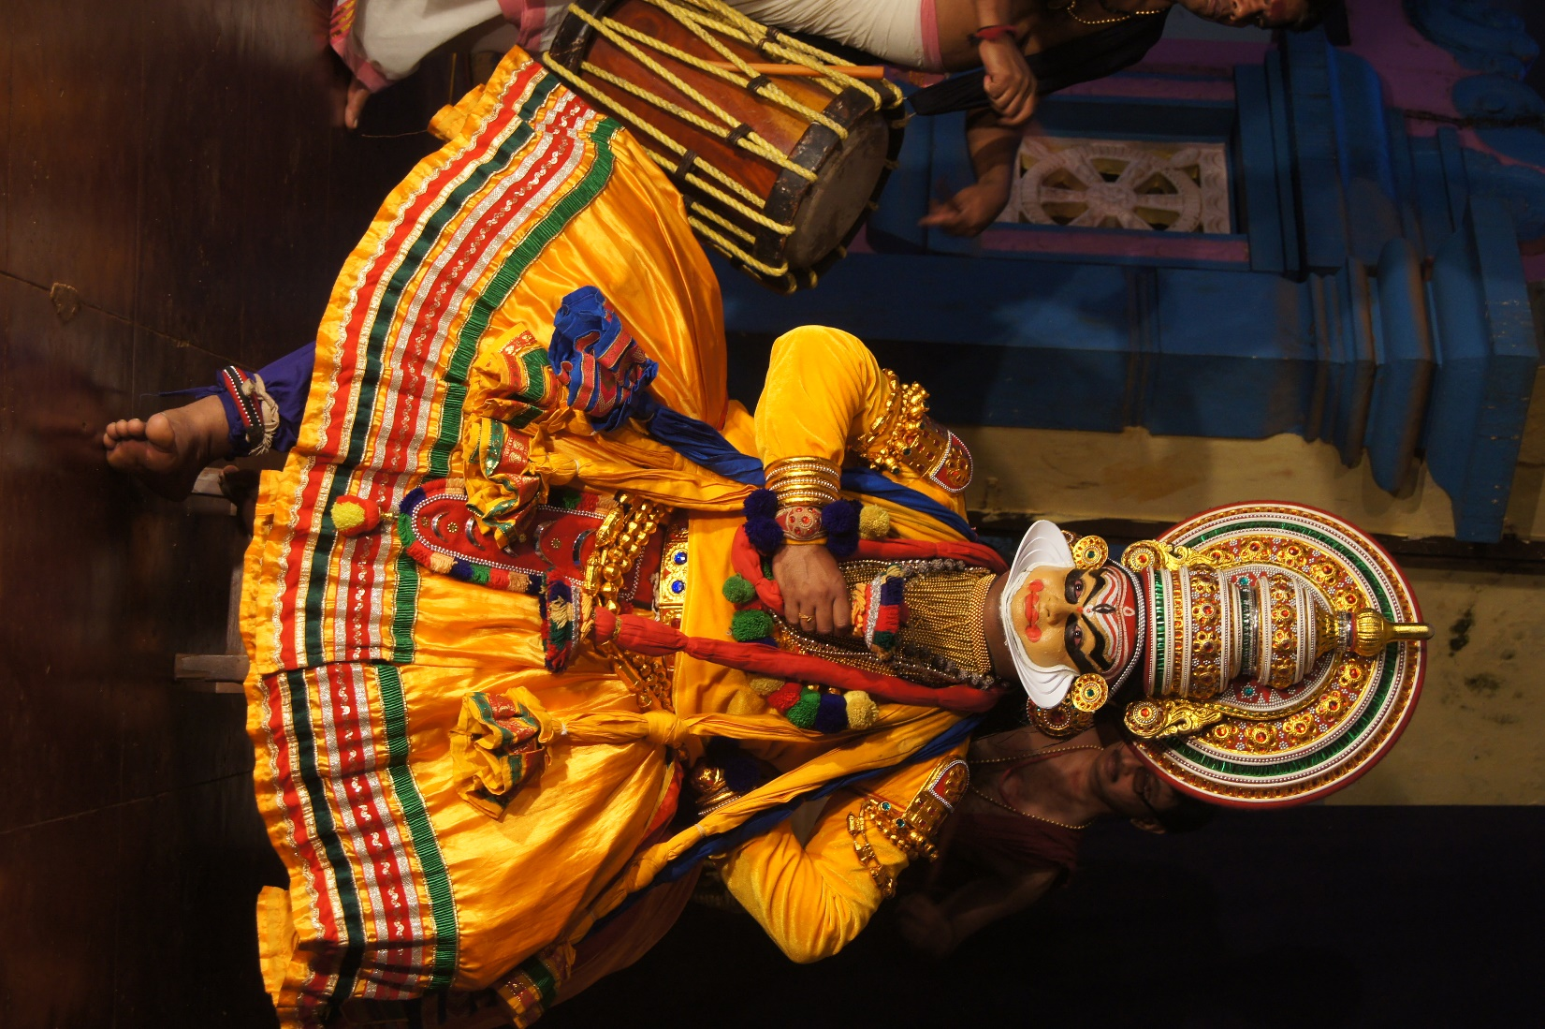


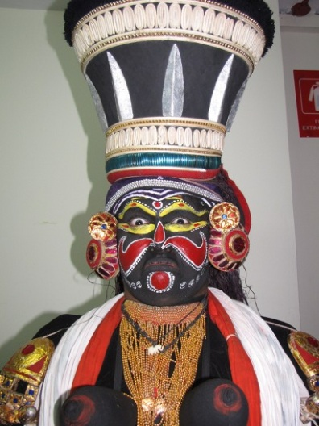
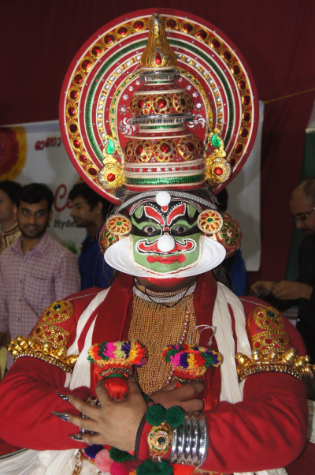
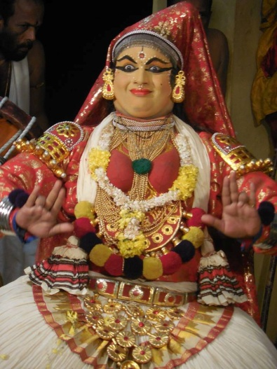
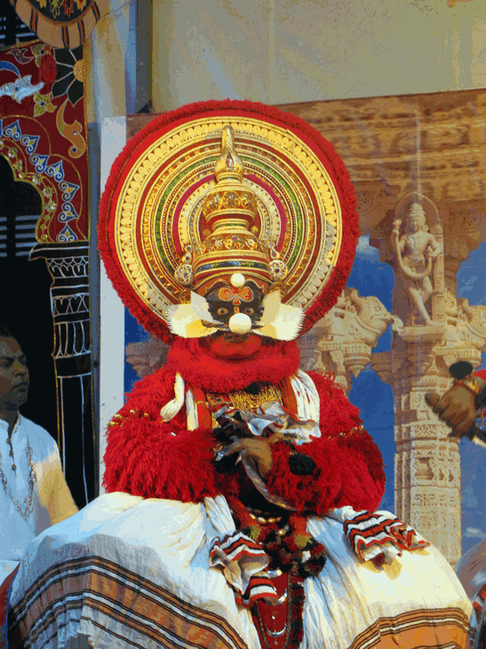
Ganesh
Masters & PhD from National University of Singapore (NUS)
Several years in Industry/Academia
Architect, Manager, Technology Evangelist, Educator
Talks/workshops in USA, Europe, Australia, Asia
Software Engineering, Cloud Computing, Artificial Intelligence, Game Theory, DevOps
Holds many industry certifications
Kathakali Dancer, YouTube Travel Vlogger, Speaker
GANESHNIYER
http://ganeshniyer.github.io

Slide 3
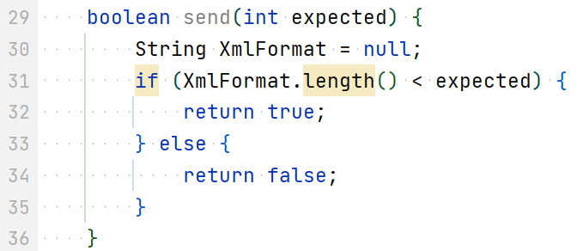
Week 3 → 4
CS2103/T [Jan, 2024]
[50 minutes]
send -> isSend, hasSend, …
XmlFormat is PascalCase. Should be camelCase (i.e., xmlFormat)
Which lines have coding standard violations?
Causes NPE?
return xmlFormat.length() < expected;

Slide 4
Code quality vs coding standard
Code quality guidelines
Follow a
coding standard (aka style guide) (aka conventions)
subjective vs objective

Slide 5
Open the week 4 Canvas quiz

Slide 6
Which one is which?
Answer this question in Week 4 Quiz (on Canvas)
Q
1
merge rebase squash
original
(a)
(b)
(c)
4
6
3
5
5
5
4
5
4
3
3+4
3
2
? force-push
2
2
2
1
1
1
The answer is auto-saved. Don’t submit the quiz yet!
1
? force-push

Slide 7
Which commits will remain if you delete branch ?
Q
2
fix1
C3
C4
C5
C6
C7
master
C7
C6
C5
C4
fix1
C3
It is common to delete branches after merging.
C2
Caution: Don’t delete branches in the iP and tP, as grading scripts check for branches
C1

Slide 8
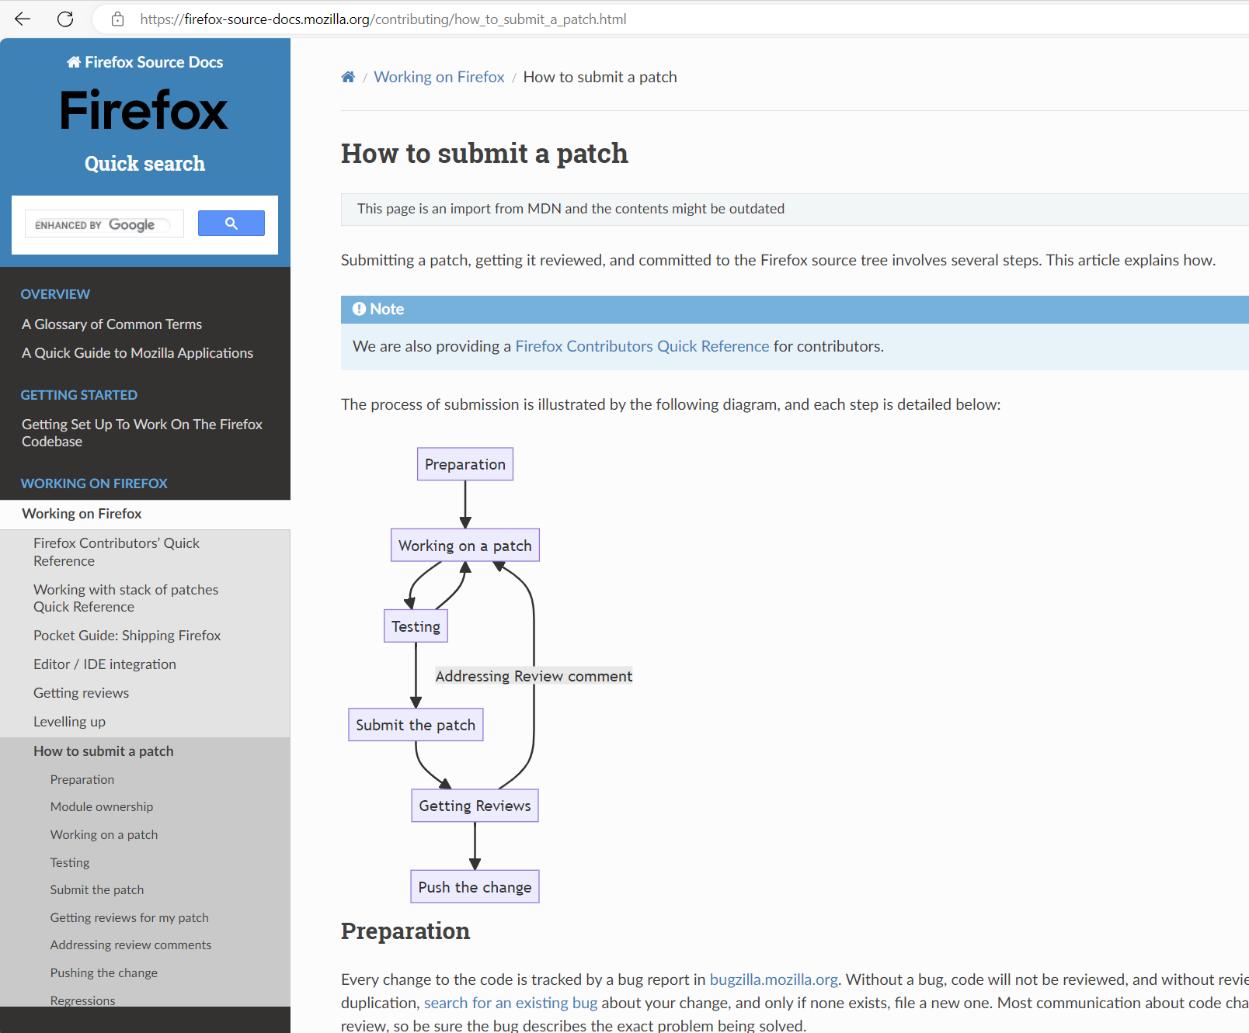
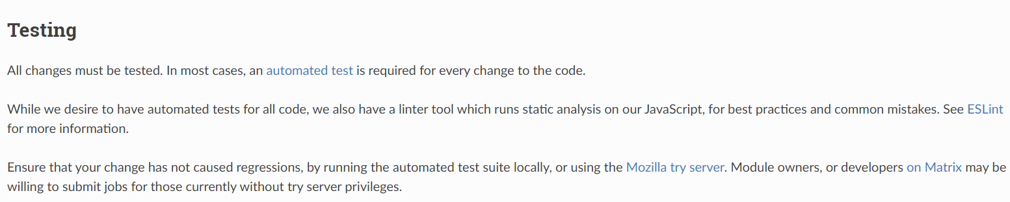
An alternative to Pull Requests.
Git can create a file (called a patch) describing your proposed changes. Git can also ‘apply’ the patch file to another repo, to add your changes to that repo.

Slide 9
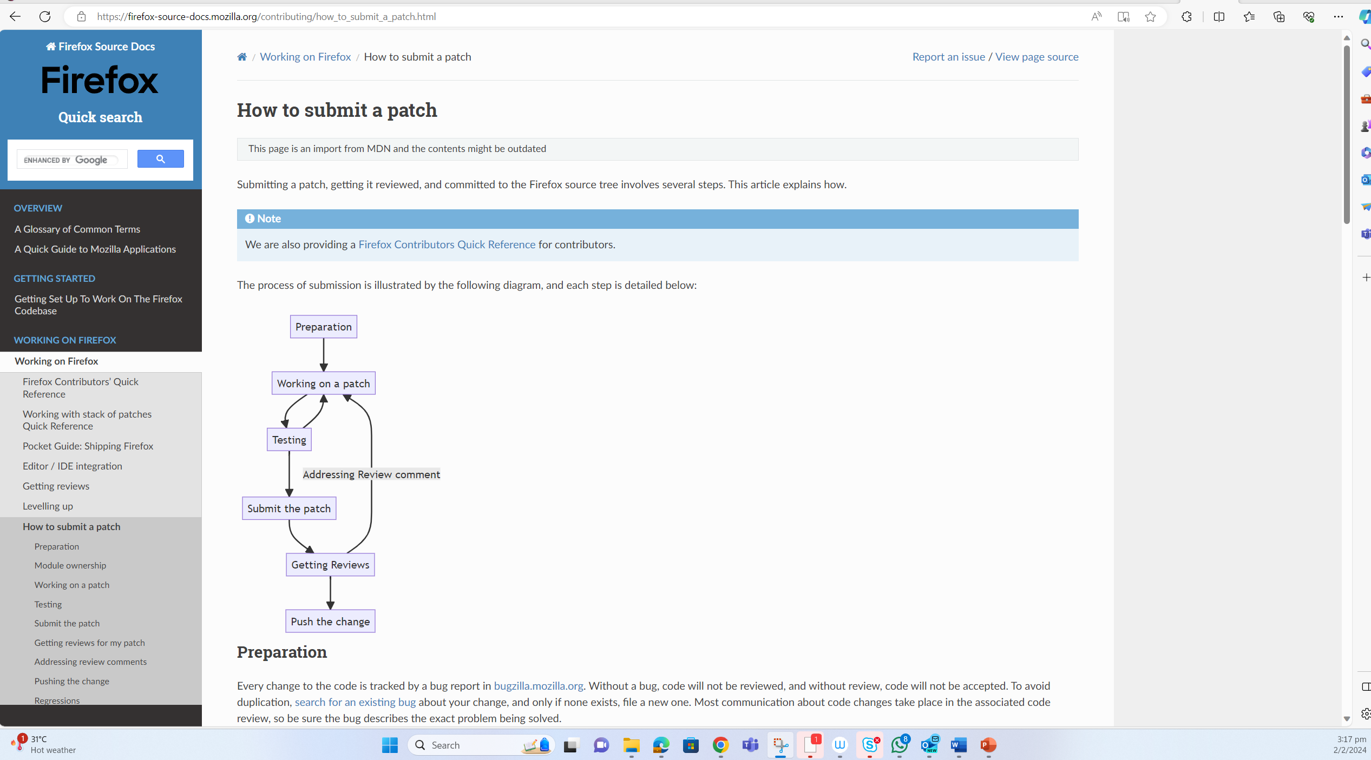

Slide 10
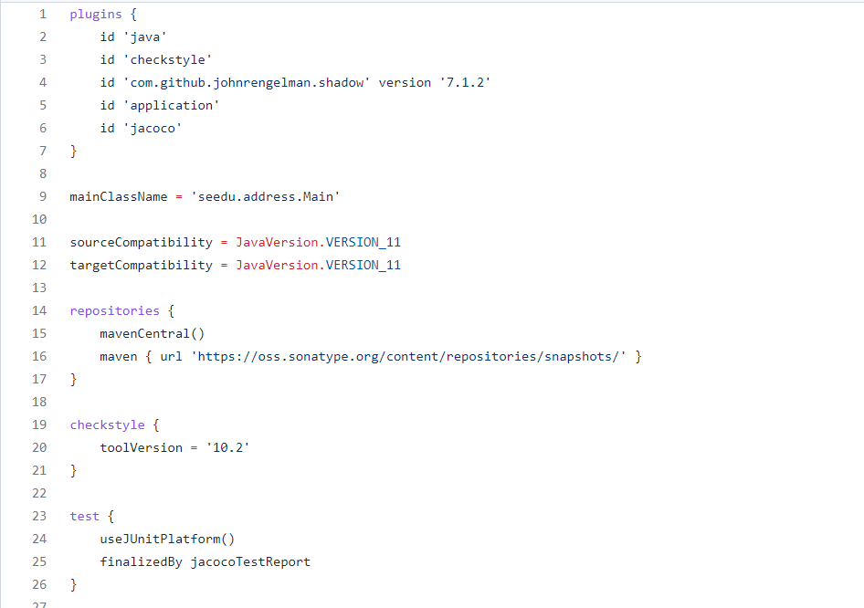

Gradle can manage dependencies too!
Gradle is used for dependency management too

Slide 11
Lecture briefing structure
Recap of the last week
+
Preview of the next week

Slide 12


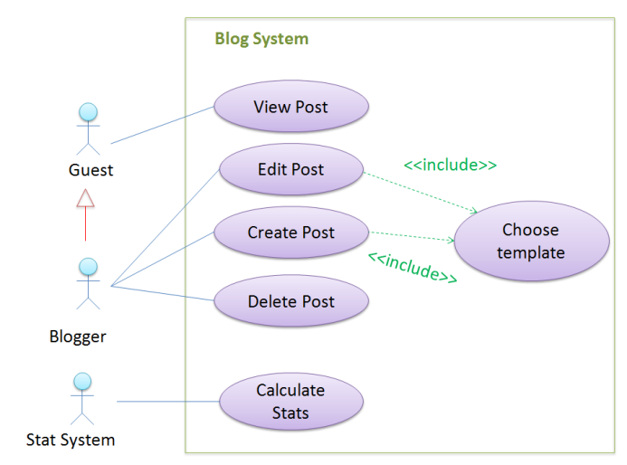
Q
3
What word is common to all three?
forward
diagram
model
person

Slide 13
models
What word is common to all three?
[… are representations of something else]

Slide 14

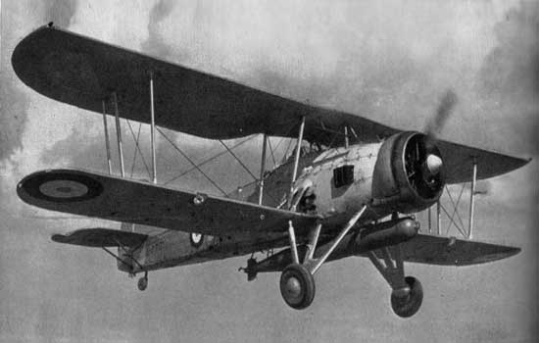



models
… are not the real thing!

Slide 15
models
… are simpler than the real thing!

Slide 16
models

Slide 17
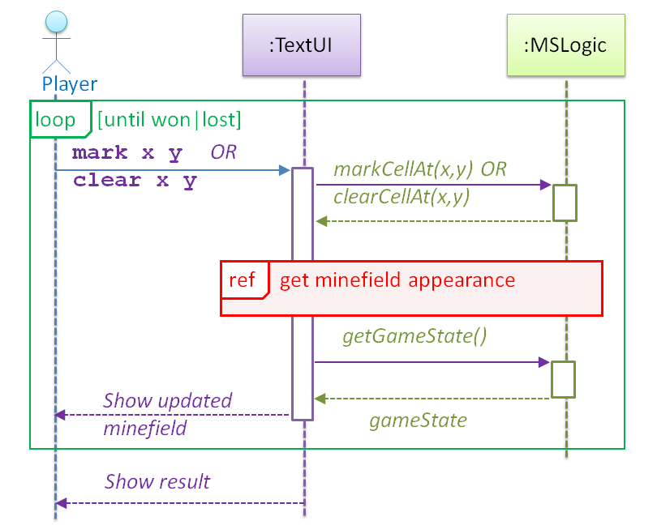
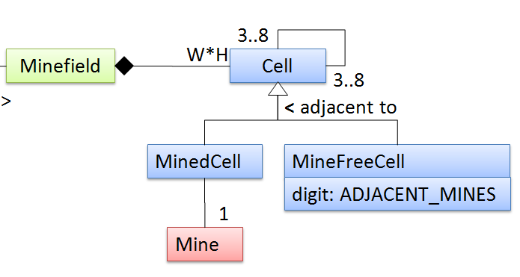

models
… capture different aspects

Slide 18


models
… combat complexity

Slide 19
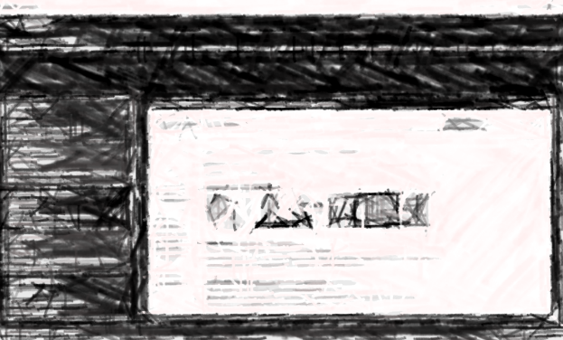


models
Small projects: can generate a mental modal on demand
bigger roles in
… are indispensable for bigger projects

Slide 20
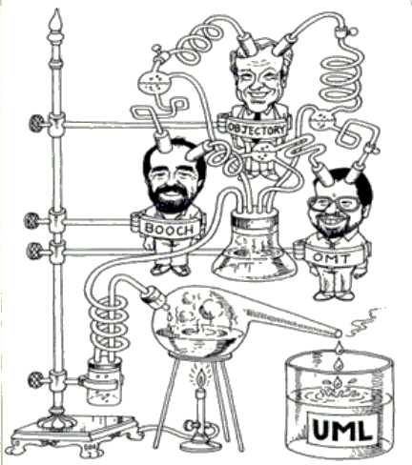
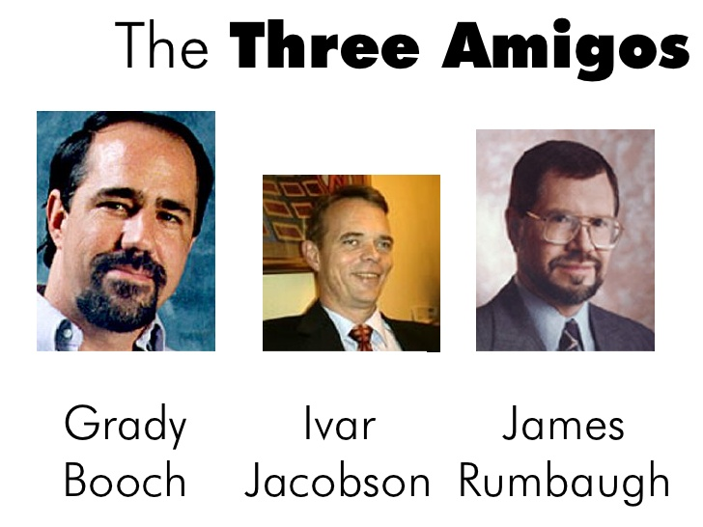
UML (Unified Modeling Language)
Grady Booch
Ivar Jacobson
James Rumbaugh

Slide 21
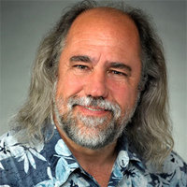
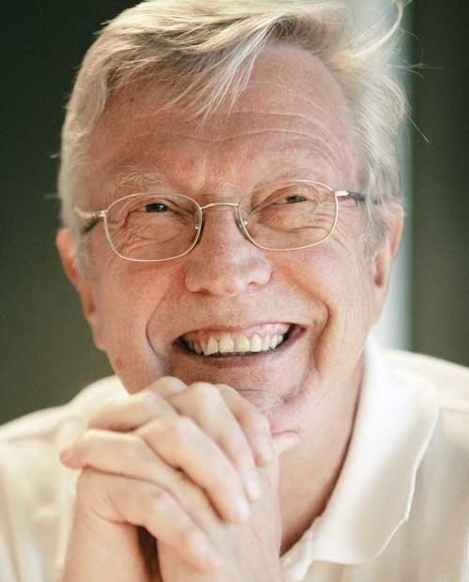
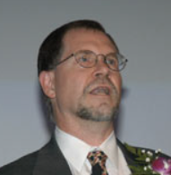
UML creators are also known as …
Q
4
The gang of four
The order of the white lotus
The three amigos
Spice boys
Grady Booch
Ivar Jacobson
James Rumbaugh

Slide 22
models
for what?
i. for analysis
ii. for communication
iii. as a blueprint

Slide 23

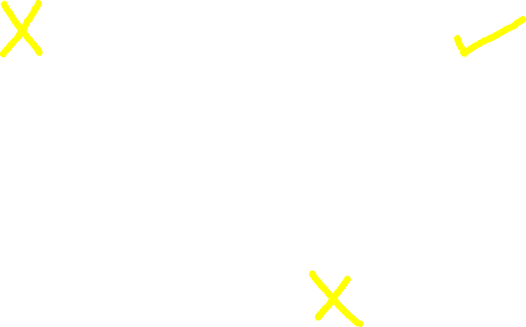
models
for what?
i. for analysis
ii. for communication
Is UML used IRL?
Nope, we don’t use UML diagrams
iii. as a blueprint

Slide 24
UML
Q
5
[ ] There are better alternatives ? No modeling ? Ad-hoc notations ? Domain-specific models e.g., a modelling notation specifically for finance domain
[ ] Not used a lot in actual practice
[ ] Over-emphasized in this course
The ability to visualize code in some other form (i.e. model code) – UML or other notations – is an essential survival skill.

Slide 25
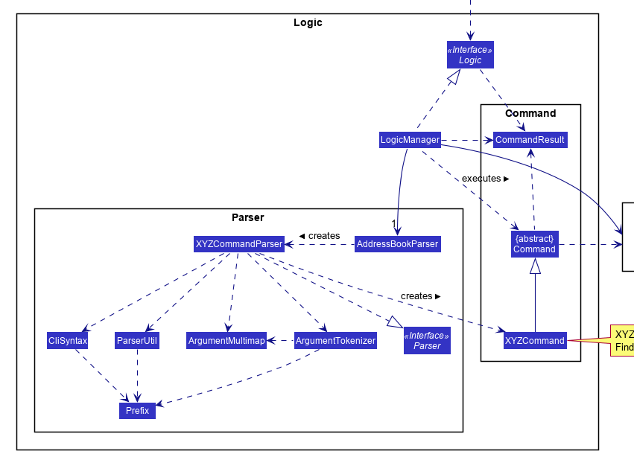
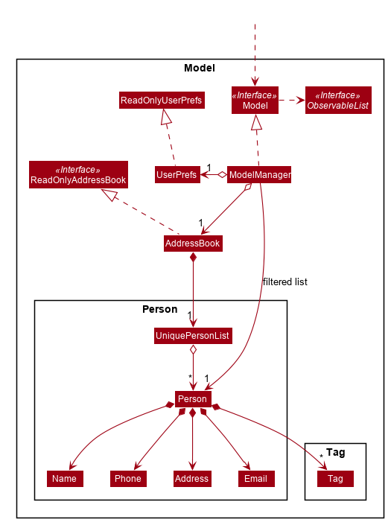
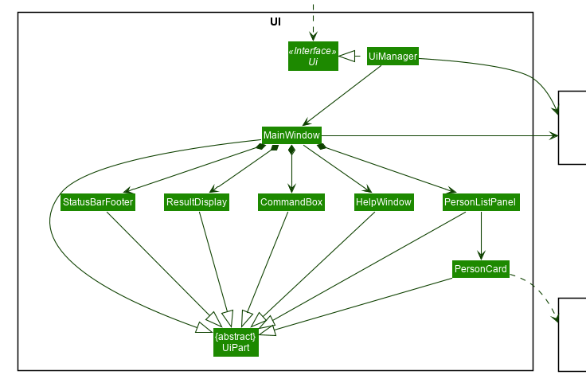
UML
Modeling structure
Modeling behavior
Class structure: class diagrams
Object structure: object diagrams
For the time being, interpreting only!
Diagram → implement code ? Not yet
Code → draw diagram? Not yet

Slide 26
Imagine this scenario in project meeting at the workplace:
Ann: An engineer, college grad
Goes to the whiteboard and …
Betsy: An intern, college student
Derrick: Tech lead/ manager
Charlie: An engineer, self-taught

Slide 27


Slide 28
Imagine this scenario in project meeting at the workplace:
Ann: An intern, college grad
- Goes to the whiteboard and …
Betsy: An intern, college student
- “Yes, but that adds another layer of abstraction; is it worth it?”
Derrick: Tech lead/ manager
- Nods in agreement
Charlie: An engineer, self-taught
- Silent

Slide 29
We aim to learn UML usage for …
Q
6
[ ] for sketching to aid discussion
[ ] for documenting
[ ] as blueprints
[ ] for code generation
[ ] for model checking
A formal methods technique that analyzes a model of a system to check whether given properties of a system are satisfied.
What prerequisite topics would you like CS2103 to cover?
CS4211 (Formal Methods for Software Engineering) Prof: I assume they know UML; I often refer to UML diagrams like class/state diagrams.
CS3203 – (Software Engineering Project) Prof:
We expect students to model the project design using UML diagram before they start coding

Slide 30
Recommended to watch the videos

Slide 33
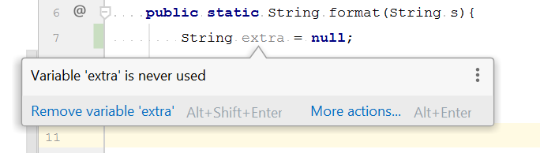

Slide 34

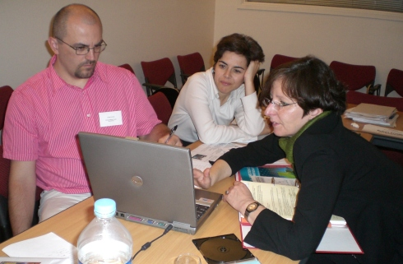

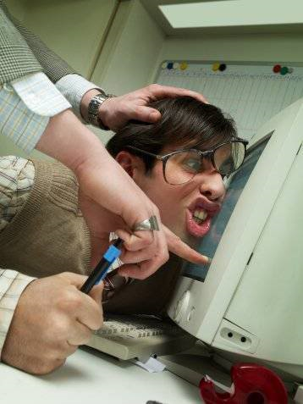
Code reviews

Slide 35
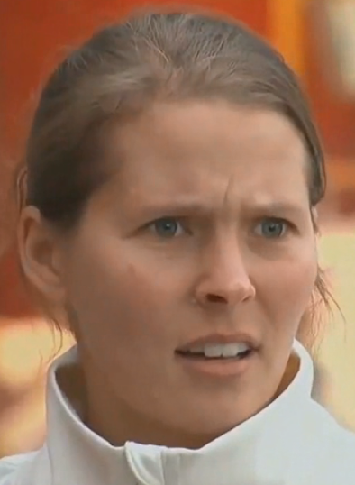
Code reviews

Slide 36
It’s harder to learn the _____ of code reviews
Q
7
( ) mechanics
( ) tools
( ) inter-personal aspects
give constructive feedback, without offending
Receive feedback, without getting offended
Respond to feedback, without getting defensive

Slide 39
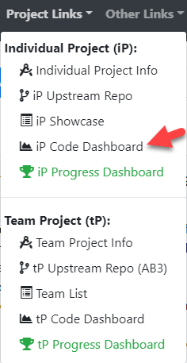
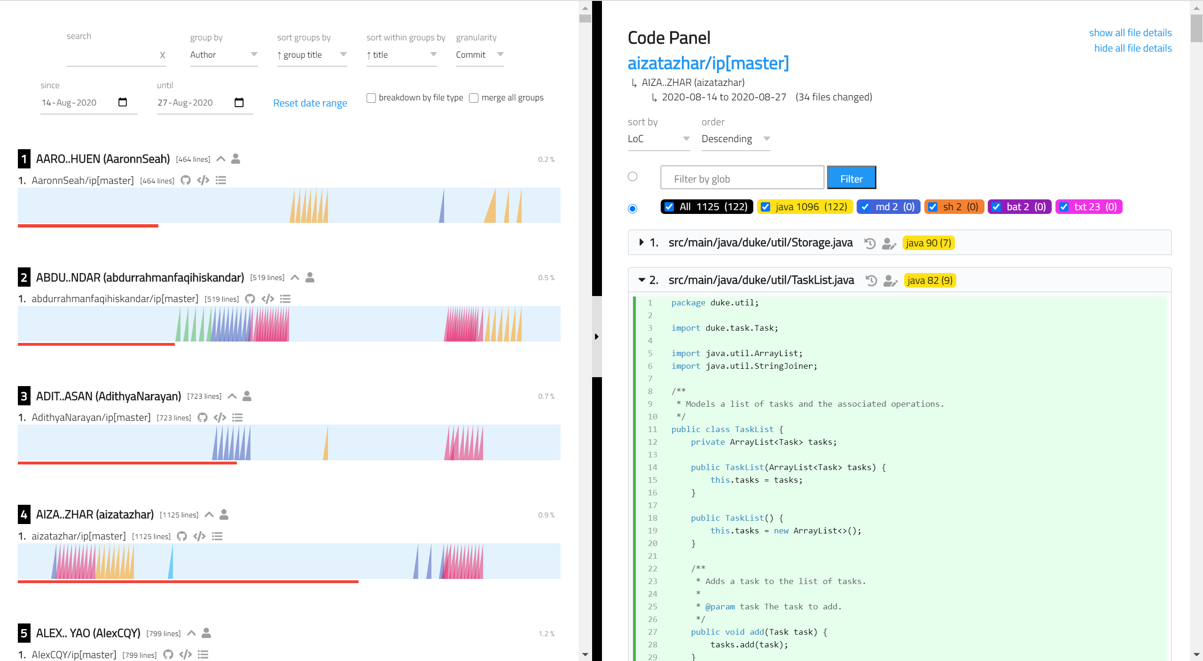
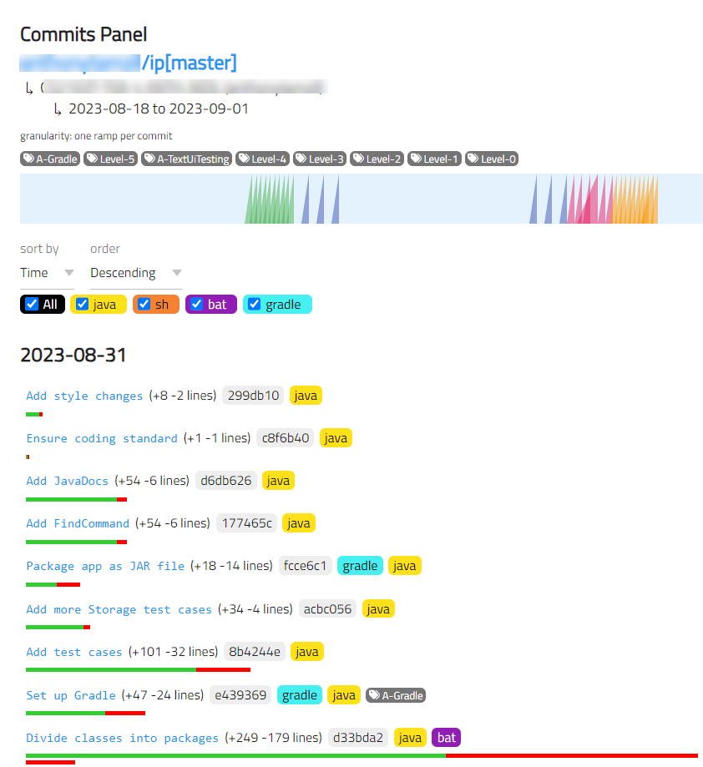
RepoSense code dashboard for the iP

Slide 40
Recommended: ___ look at others’ code
Q
8
( ) Don’t
( ) Please
In the area of AI-assisted coding, reviewing not-your-own code (e.g., code generated by AI) is an even more valuable skill.
[but follow our reuse policies]
[automated plagiarism checks on tP (not iP) code]

Slide 41
Watch the ‘tP – part 1’ course briefing video segment (given in W4 schedule page)

Slide 43
